Slide 1


Case Management
Mohammed Almughalles

Slide 2

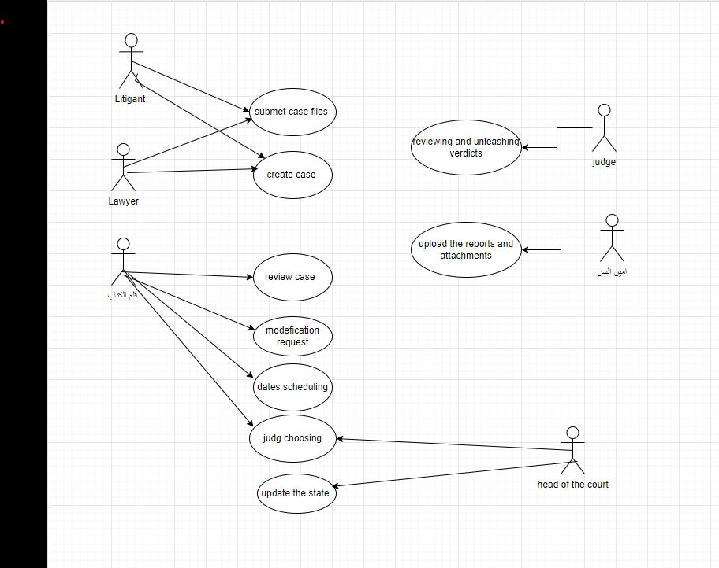
Use Case Management

Slide 3
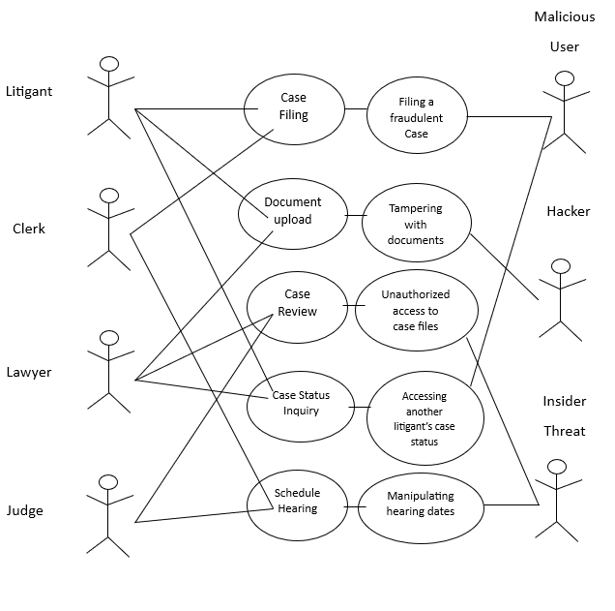
Use Case Management

Slide 4
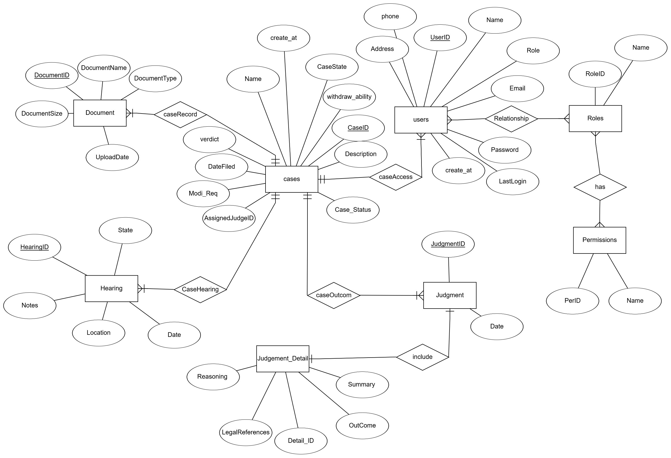
Entity-Relationship Diagram

Slide 5
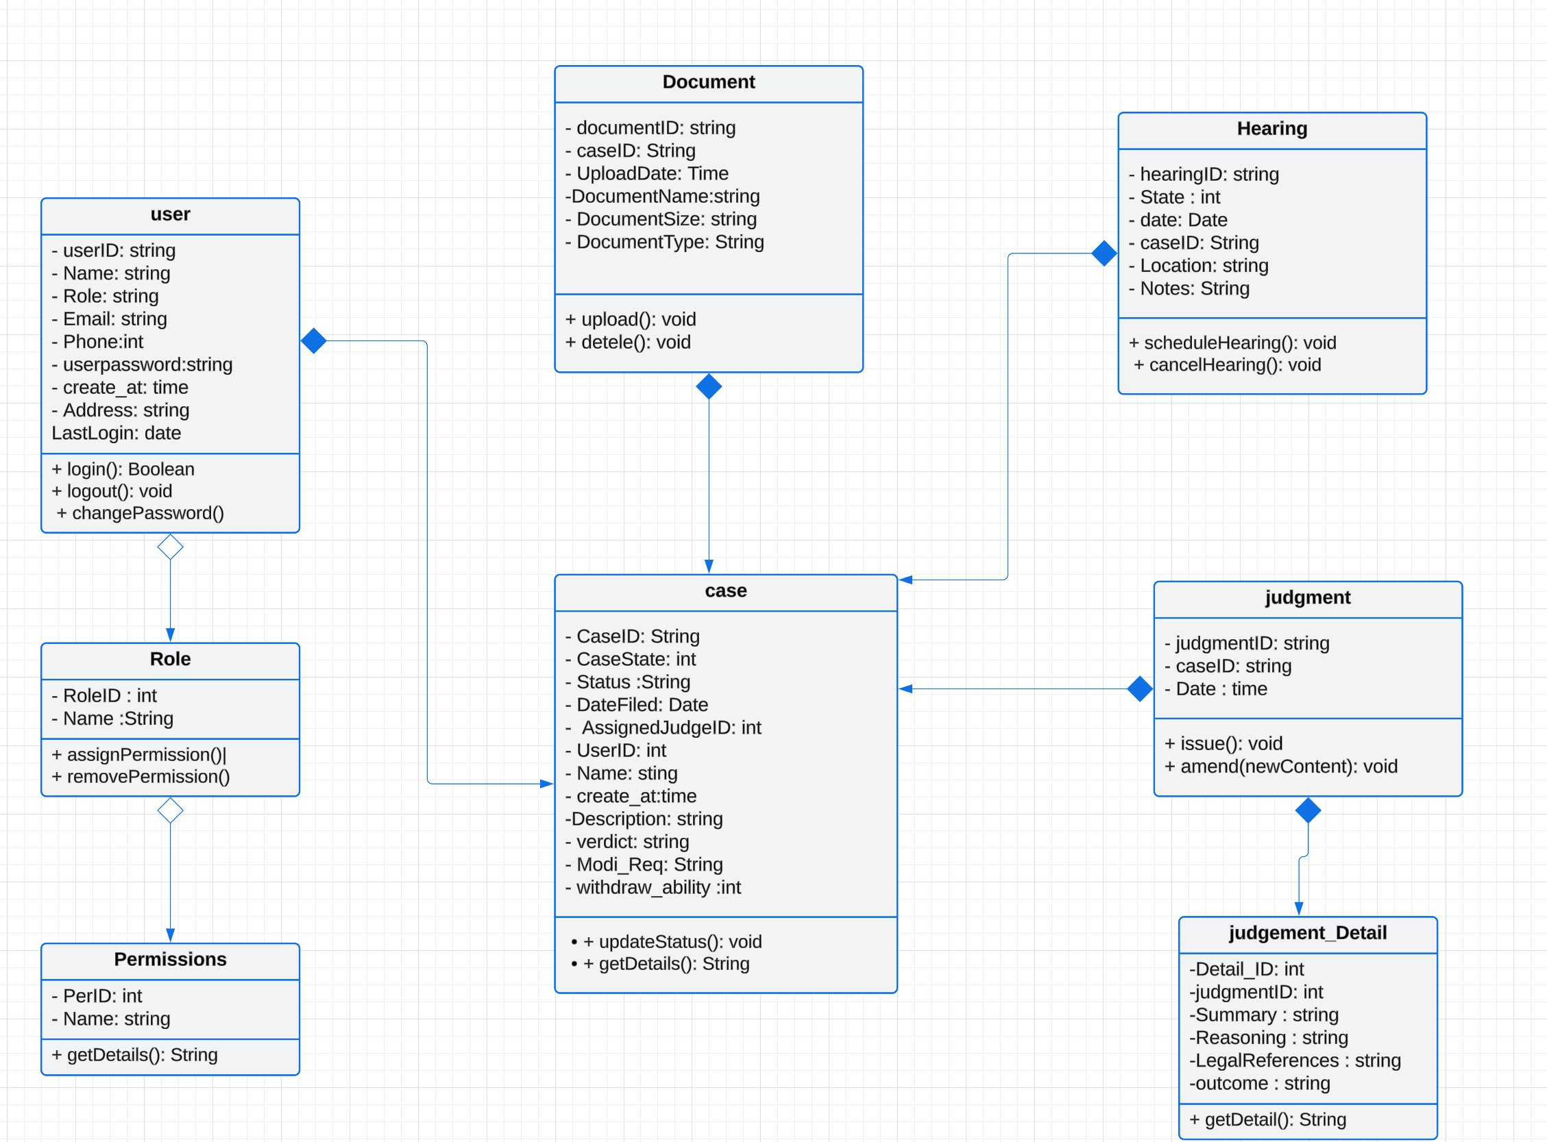
Class Diagram

Slide 6
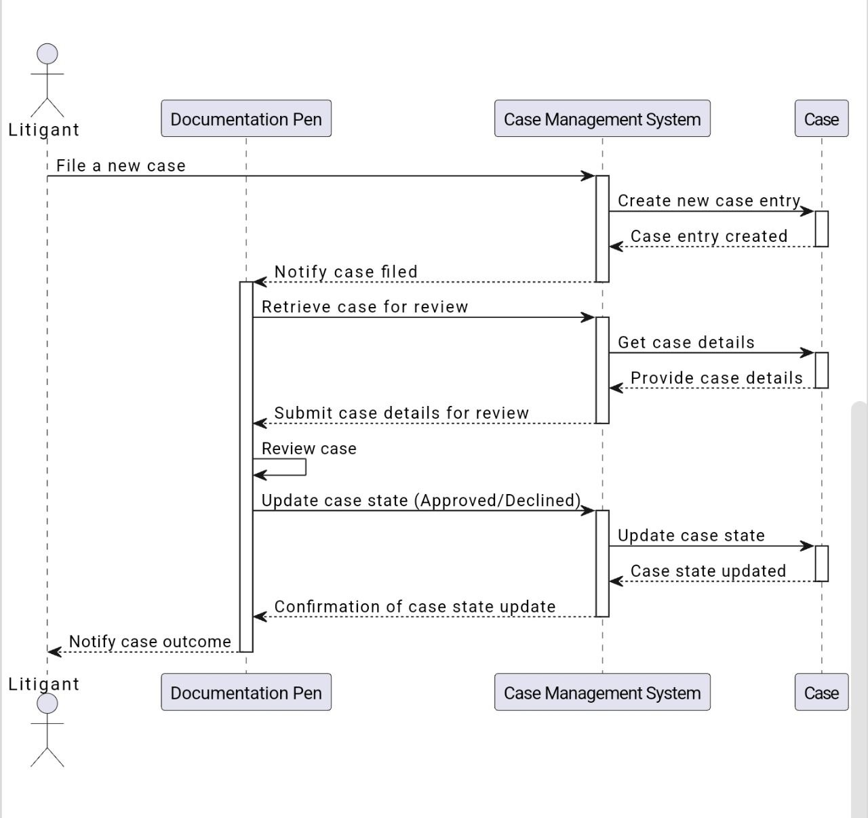
Sequence Diagram

